Slide 1
MultiDraw
Software Engineering Languages & Tools
Spring 2009
Final-Project
TEAM 1
Joseph Trapani
Ben Helppi
Satpreet Singh
Mark D'Souza
Amanda Parker

Slide 2
Technology Choice
We had considered:
Java RMI
XML / SOAP
Sockets
Chose: Sockets
for their simplicity (learning curve)
get a real feel for distributed system issues

Slide 3
Architecture
Continued with MVC as was used in ObjectDraw
Distributed System consists of interacting components:
Multiple instances of MultiDraw stand-alone
Defined a custom interface / protocol over Java sockets
Networking model:
Pure P2P system, connection done in a semi client/server fashion before peer is fully connected.
Dynamic loading accommodated separately

Slide 4
Starting a collaboration [Client-Server communication]
Listening on open server-socket
Connect to server’s socket
Owner
(Server)
New User
(Client)
Accepts connection; makes I/O streams
If accepted, makes I/O streams
Sends session join request
1. Accepts session join request
2. Sends list of currently connected clients & canvas-state
Makes I/O streams to new peers
Periodic canvas event updates, etc…

Slide 5
Chat messages [P2P communication]
User1
(Peer)
Chat Message sent out to all known peers
User2
(Peer)
User3
(Peer)
User4
(Peer)
P2P Network is fully connected

Slide 6
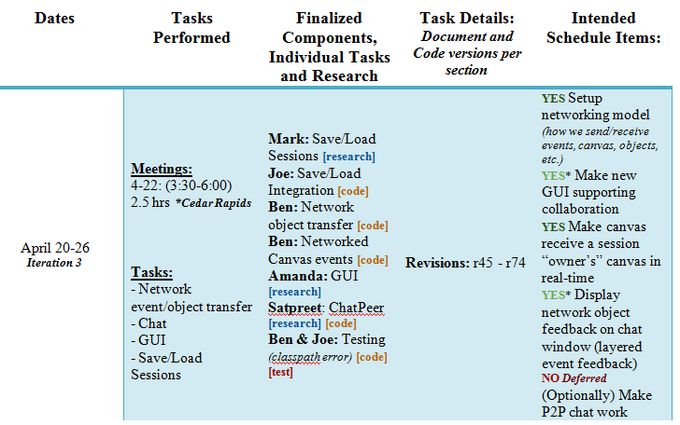
Schedule: Actual vs. Intended
Four iterations plus pre & post production phases
Each iteration had specific tasks and hard deadlines
Over 20 face-to-face meetings/work hours
All goals pre-iteration 4 met
deferred 2 of 5 final goals
26 total goals spanning all iterations, 23 met completely, 1 met partially, 2 deferred/shelved
Dynamic tool loading and tool sending/receiving
Example iteration from our schedule tracker

Slide 7
Lessons Learnt/Conclusions
Sockets didn’t work as expected.
- Java support for asynchronous operations is non existent.
- But Object streams were easy to use.
2. Underestimated work on reflection
3. On-boarding group members to common set of code took longer than expected.

Slide 8
Viva la Collaboracíon!
Live demo follows…

